Slide 1
SS ZG 526: Distributed Computing
Distributed Mutual Exclusion (DME)
Chittaranjan Hota
Professor, Dept. of Computer Sc. & Information Systems
BITS, Pilani Hyderabad Campus, Hyderabad
hota@hyderabad.bits-pilani.ac.in

Slide 2
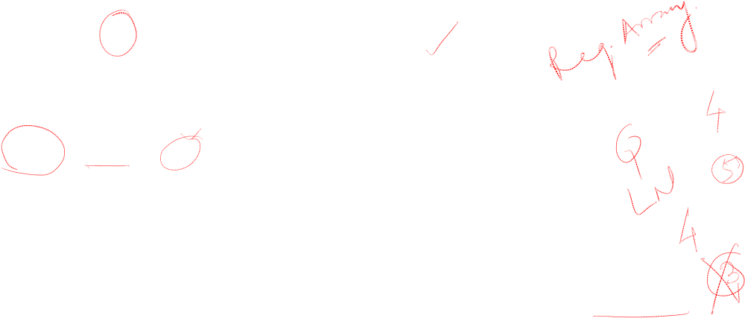
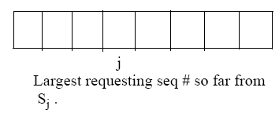
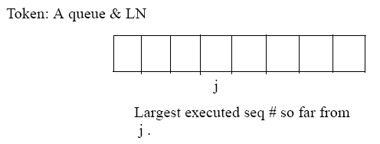
Suzuki-kasami broadcast DME
A site has RN:
LN[j] is the sequence no. of the request that site S_{j} executed most recently.
Birla Institute of Technology and Science, Pilani (Deemed University)

Slide 3

The DME algorithm
Requesting the critical section.
1. If the requesting site S_{i} does not have the token, then it increments it’s sequence number, RN_{i} [i], and sends a REQUEST(i, sn) message to all other sites. (sn is the updated value of RN_{i} [i].)
2. When a site S_{j} receives this message, it sets RN_{j} [i] to max(RN_{j} [i], sn). If S_{j} has the idle token, it sends the token to S_{i} if RN_{j} [i] = LN[i] + 1.
Executing the critical section.
3. Site S_{i} executes the CS when it has received the token.
Releasing the critical section.
Having finished the execution of the CS, site S_{i} takes the following actions:
4. It sets LN[i] element of the token array equal to RN_{i} [i].
5. For every site S_{j} whose ID is not in the token queue, it appends its ID to the token queue if RN_{i} [j] = LN[j] + 1.
6. If token queue is nonempty after the above update, then it deletes the top site ID from the queue and sends the token to the site indicated by the ID.
Birla Institute of Technology and Science, Pilani (Deemed University)

Slide 4
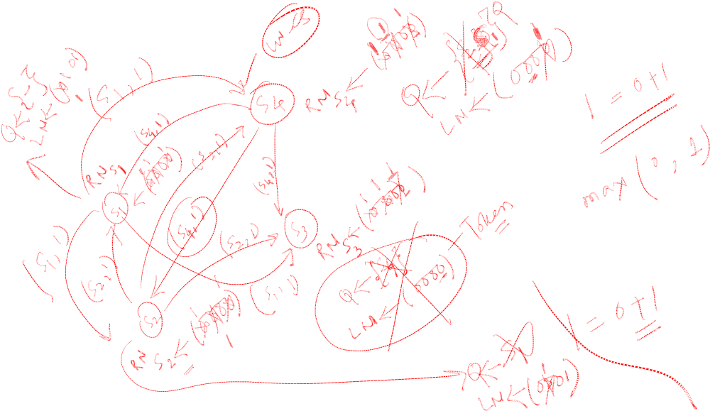
Example
Birla Institute of Technology and Science, Pilani (Deemed University)

Slide 5
Analysis of the DME algorithm
Correctness
Mutex is trivial.
  Theorem:
A requesting site enters the CS in finite amount of time.
  Proof:
A request enters the token queue in finite time. The queue is in FIFO order, and there can be a maximum N-1 sites ahead of the request.
Performance
0 or N messages per CS invocation.
Birla Institute of Technology and Science, Pilani (Deemed University)

Slide 6
Next Session
Raymonds tree based DME
Birla Institute of Technology and Science, Pilani (Deemed University)

